Slide 1



Sponsored by:

Slide 2

From Data to Impact: Harnessing ALICE to Create Lasting Community Change
Brittany Burnett
United Way of the CSRA

Slide 3

Community Foundation for the CSRA Non-Profit Summit
May 2, 2024

Slide 4
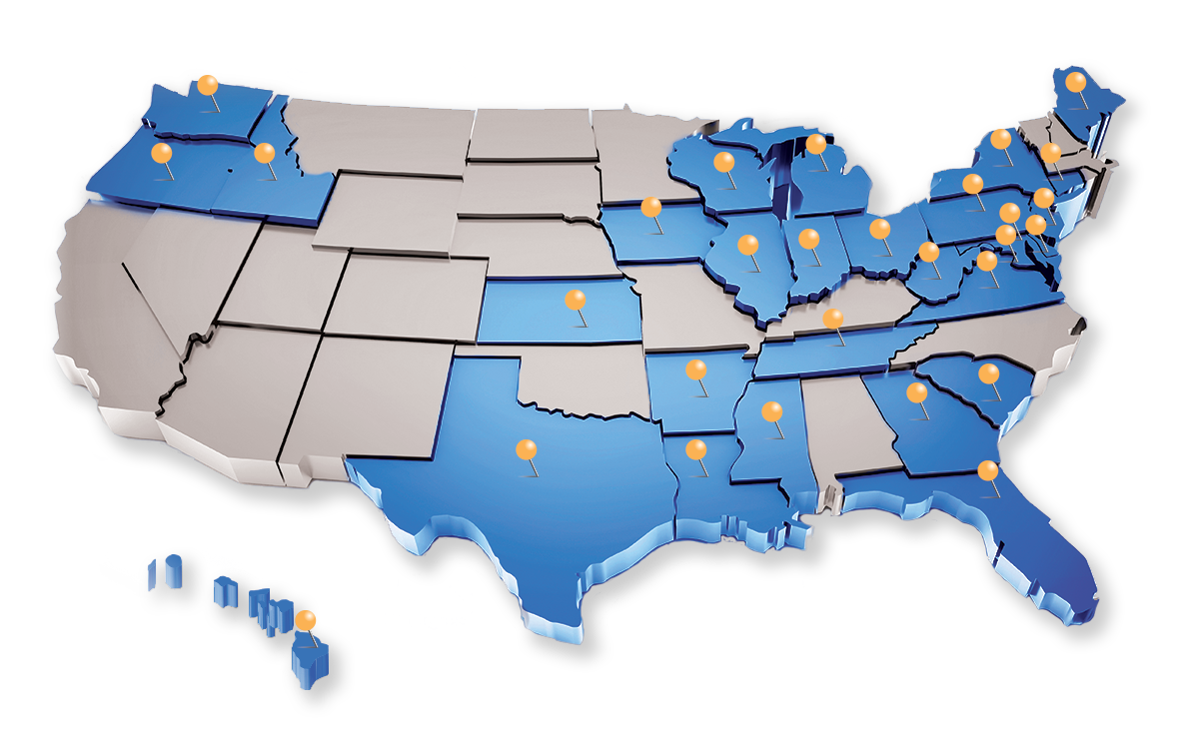
We Are United For ALICE
Founded and powered by United Way
of Northern New Jersey, brought to
Indiana by Indiana United Ways
Driver of innovation for ALICE
households since 2009
Comprehensive measures of
financial hardship
Data for all 3,000+ counties in U.S.
ALICE partners convene, advocate, and innovate for ALICE in local communities
UnitedForALICE.org
Notes:
United For ALICE is a driver of innovation, shining a light on the challenges ALICE (Asset Limited, Income Constrained, Employed) households face and finding collaborative solutions. Through
a standardized methodology that assesses the cost of living in every county, this project provides a comprehensive measure of financial hardship across the U.S. Equipped with this data,
ALICE partners convene, advocate, and innovate in their local communities to highlight the issues faced by ALICE households and to generate solutions that promote financial stability. The
grassroots movement represents United Ways, corporations, nonprofits and foundations in Arkansas, Connecticut, Delaware, D.C., Florida, Georgia, Hawai‘i, Idaho, Illinois, Indiana, Iowa,
Kansas, Louisiana, Maine, Maryland, Michigan, Mississippi, New Jersey, New York, Ohio, Oregon, Pennsylvania, Tennessee, Texas, Virginia, Washington, West Virginia, and Wisconsin; we are
United For ALICE.
Vision: We envision a world where all those who work to keep our economy running can support themselves and their families
Mission: Become the standard measure used by nonprofit, government, business, and academic institutions to define financial insecurity; change the common vernacular from “working poor” to “ALICE”

Slide 5
Meet ALICE
Asset Limited, Income Constrained, Employed
Income above the Federal Poverty Level, below the cost of basics in the county where they live (Household Survival Budget)
Working, often in essential jobs
Little or no savings — for emergencies or future investments
Notes:
Asset Limited, Income Constrained, Employed
Above FPL, below Household Survival Budget
Low-wage jobs – cashiers, health care workers, security guards, laborers, office administration
No savings:
For emergencies
For investing in the future – education, homeownership, retirement
Leaders across the U.S. talk about low-income workers who have been forgotten, left behind, or treated as if they’re invisible. United For ALICE shows that this group already has a name — ALICE — and presents a set of more accurate, data-driven measures of how many households across the country are in hardship.

Slide 6
Challenges ALICE Faces
Extent of hardship concealed by outdated Federal Poverty Level
Wages not keeping up with cost of basics and costs on the rise (esp. food, housing)
Inflation and crisis hit harder
Often earning too much for traditional public assistance
Elevated anxiety and depression

Slide 7
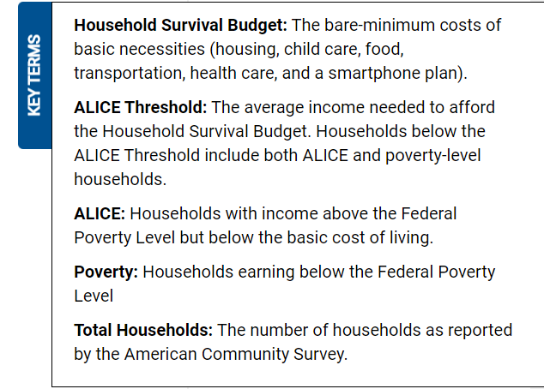
Key Terms and Methodology
Visit UnitedForALICE.org/Methodology to learn more

Slide 8
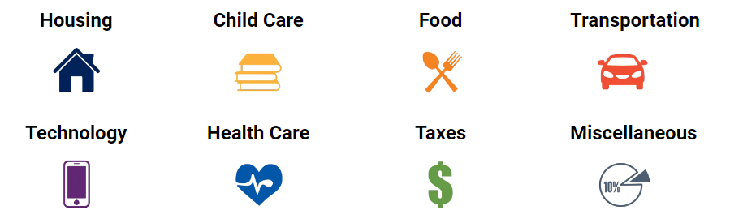
The ALICE Household Survival Budget
The Household Survival Budget reflects the minimum cost to live and work in the modern economy. This budget is the basis for determining whether households are above or below the ALICE Threshold by county.
UnitedForALICE.org/Household-Budgets/Georgia
Notes:
Housing: Rent: Fair Market Rent (40th percentile) for an efficiency, one-bedroom, or two-bedroom apartment (based on family size), adjusted in metro areas using the American Community
Survey (ACS) – minus utilities.
Utilities: As captured by the Community Expenditure Survey (CEX)
Update: Cost of rent and utilities now shown separately.
Sources: Rent – U.S. Department of Housing and Urban Development; ACS metro housing costs. Utility costs – CEX
Child Care: Cost for registered Family Child Care Homes for infants (age 0–2 years), preschool (age 3–4), and school-age children (age 5–12).
Source: State agency responsible for child care cost reporting
Food: USDA Thrifty Food Plan by age with county variation from Feeding America
Update: Change in legislation requires the USDA Thrifty Food Plans to reflect the cost for resource-constrained households to purchase a healthy, practical diet, starting in 2021, increasing
costs from prior years
Sources: U.S. Department of Agriculture (USDA); Feeding America
Transportation: Operating costs for a car (based on average daily miles by age, cost per mile, license, fees, and insurance), or public transportation where viable
Update: The reduction in public transportation use during the pandemic reduced the average expenditure, yet the cost to commute remained the same. To reflect this, the budget uses
2019 average CEX expenditures.
Sources: Federal Highway Administration, AAA, The Zebra (car costs);
CEX (for public transportation)
Health Care: Health insurance premiums based on employer-sponsored health insurance plus out-of-pocket costs for $40K–$69K households by age, weighted with poor health multiplier.
For senior budget, cost of Medicare Part A & B, out-of-pocket costs, plus out-of-pocket average spending for the top five chronic diseases as reported by CMS.
Sources: Medical Expenditure Panel Survey (MEPS), Consumer Expenditure Survey, Centers for Medicare & Medicaid Services (CMS)
Technology: Smartphone plan with 10GB of data for each adult in a household
Update: costs were upgraded from the basic smartphone plan to a 10GB monthly data plan for each adult in the household to reflect the increased need for internet access starting in 2020.
Source: Consumer Reports
Taxes: Federal, state, and local taxes (payments), as well as tax credits, including the Child Tax Credit and the Child and Dependent Care Credit.
Update: Due to expanded tax credits in 2021, the cost of tax payments and credits now shown separately.
Source: Internal Revenue Service, Tax Foundation
Miscellaneous: Cost overruns estimated at 10% of budget the budget, including taxes.

Slide 9
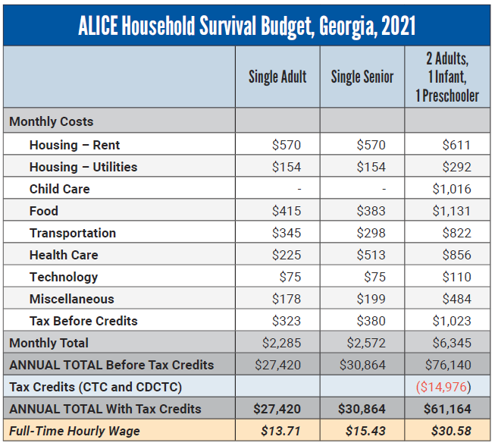

Basic Costs in Georgia

Slide 10
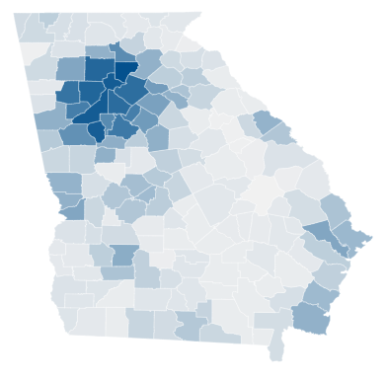
Cost of Living Varies Across the State
The annual total for the Household Survival Budget for a family of four with two adults, an infant and a preschooler ranged from $53,124 in Emanuel County to $92,208 in Forsyth County.
The actual cost of household basics in every county in Georgia is well above the FPL for all household sizes and types.
Itemized budgets for all counties and regions at UnitedForALICE.org/household-budgets/Georgia

Slide 11
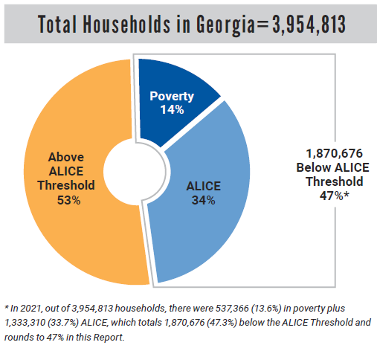

Understanding Financial Hardship

Slide 12
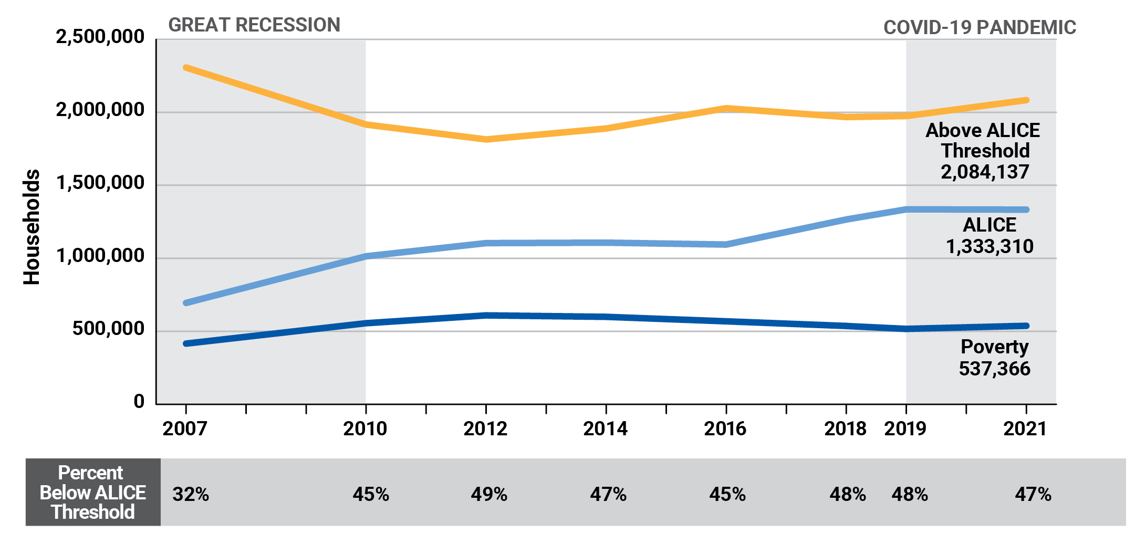
Financial Hardship Over Time

Slide 13
Financial Hardship Varies by Location
The percentage of households below the ALICE Threshold ranged from 27% in Forsyth County to 76% in both Randolph and Wheeler counties
Variation within counties, e.g., range
from 19% to 82% within Fulton County
Rural counties (52%), Urban counties (47%)

Slide 14

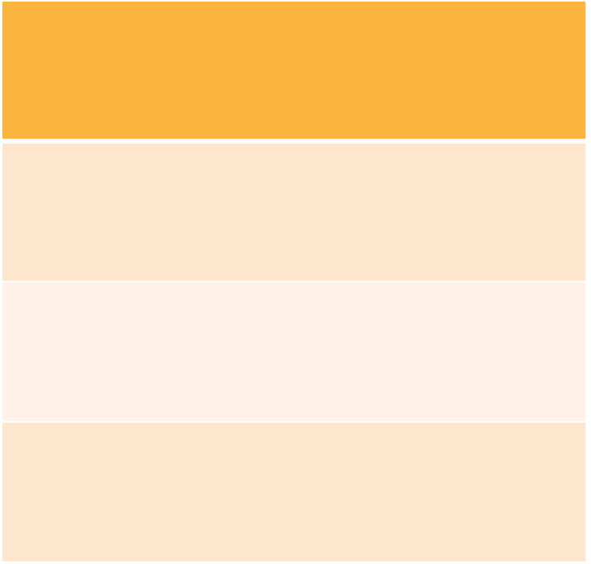
Demographics of Households in Hardship
Highest % Hardship
Lowest % Hardship
Indigenous, Black, and Hispanic
White
Under 25 and 65+
Working Age
Single-parent
Married-parent

Slide 15
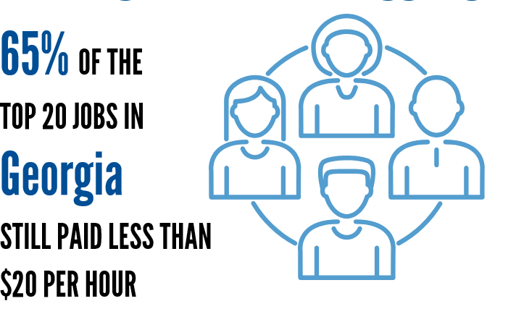
Working Hard, Yet Struggling
For a common occupation in Georgia (retail sales), the median wage increased by 6% to $11.53 per hour in 2021, but 35% of the more than 132,000
retail salespeople were still below the ALICE Threshold
Notes:
While there were ALICE workers in all sectors, of these top Georgia occupations, those with the highest percentage of workers below the ALICE Threshold in 2021 were
cooks, cashiers, stockers and order fillers, waiters and waitresses, and fast food and counter workers.

Slide 16
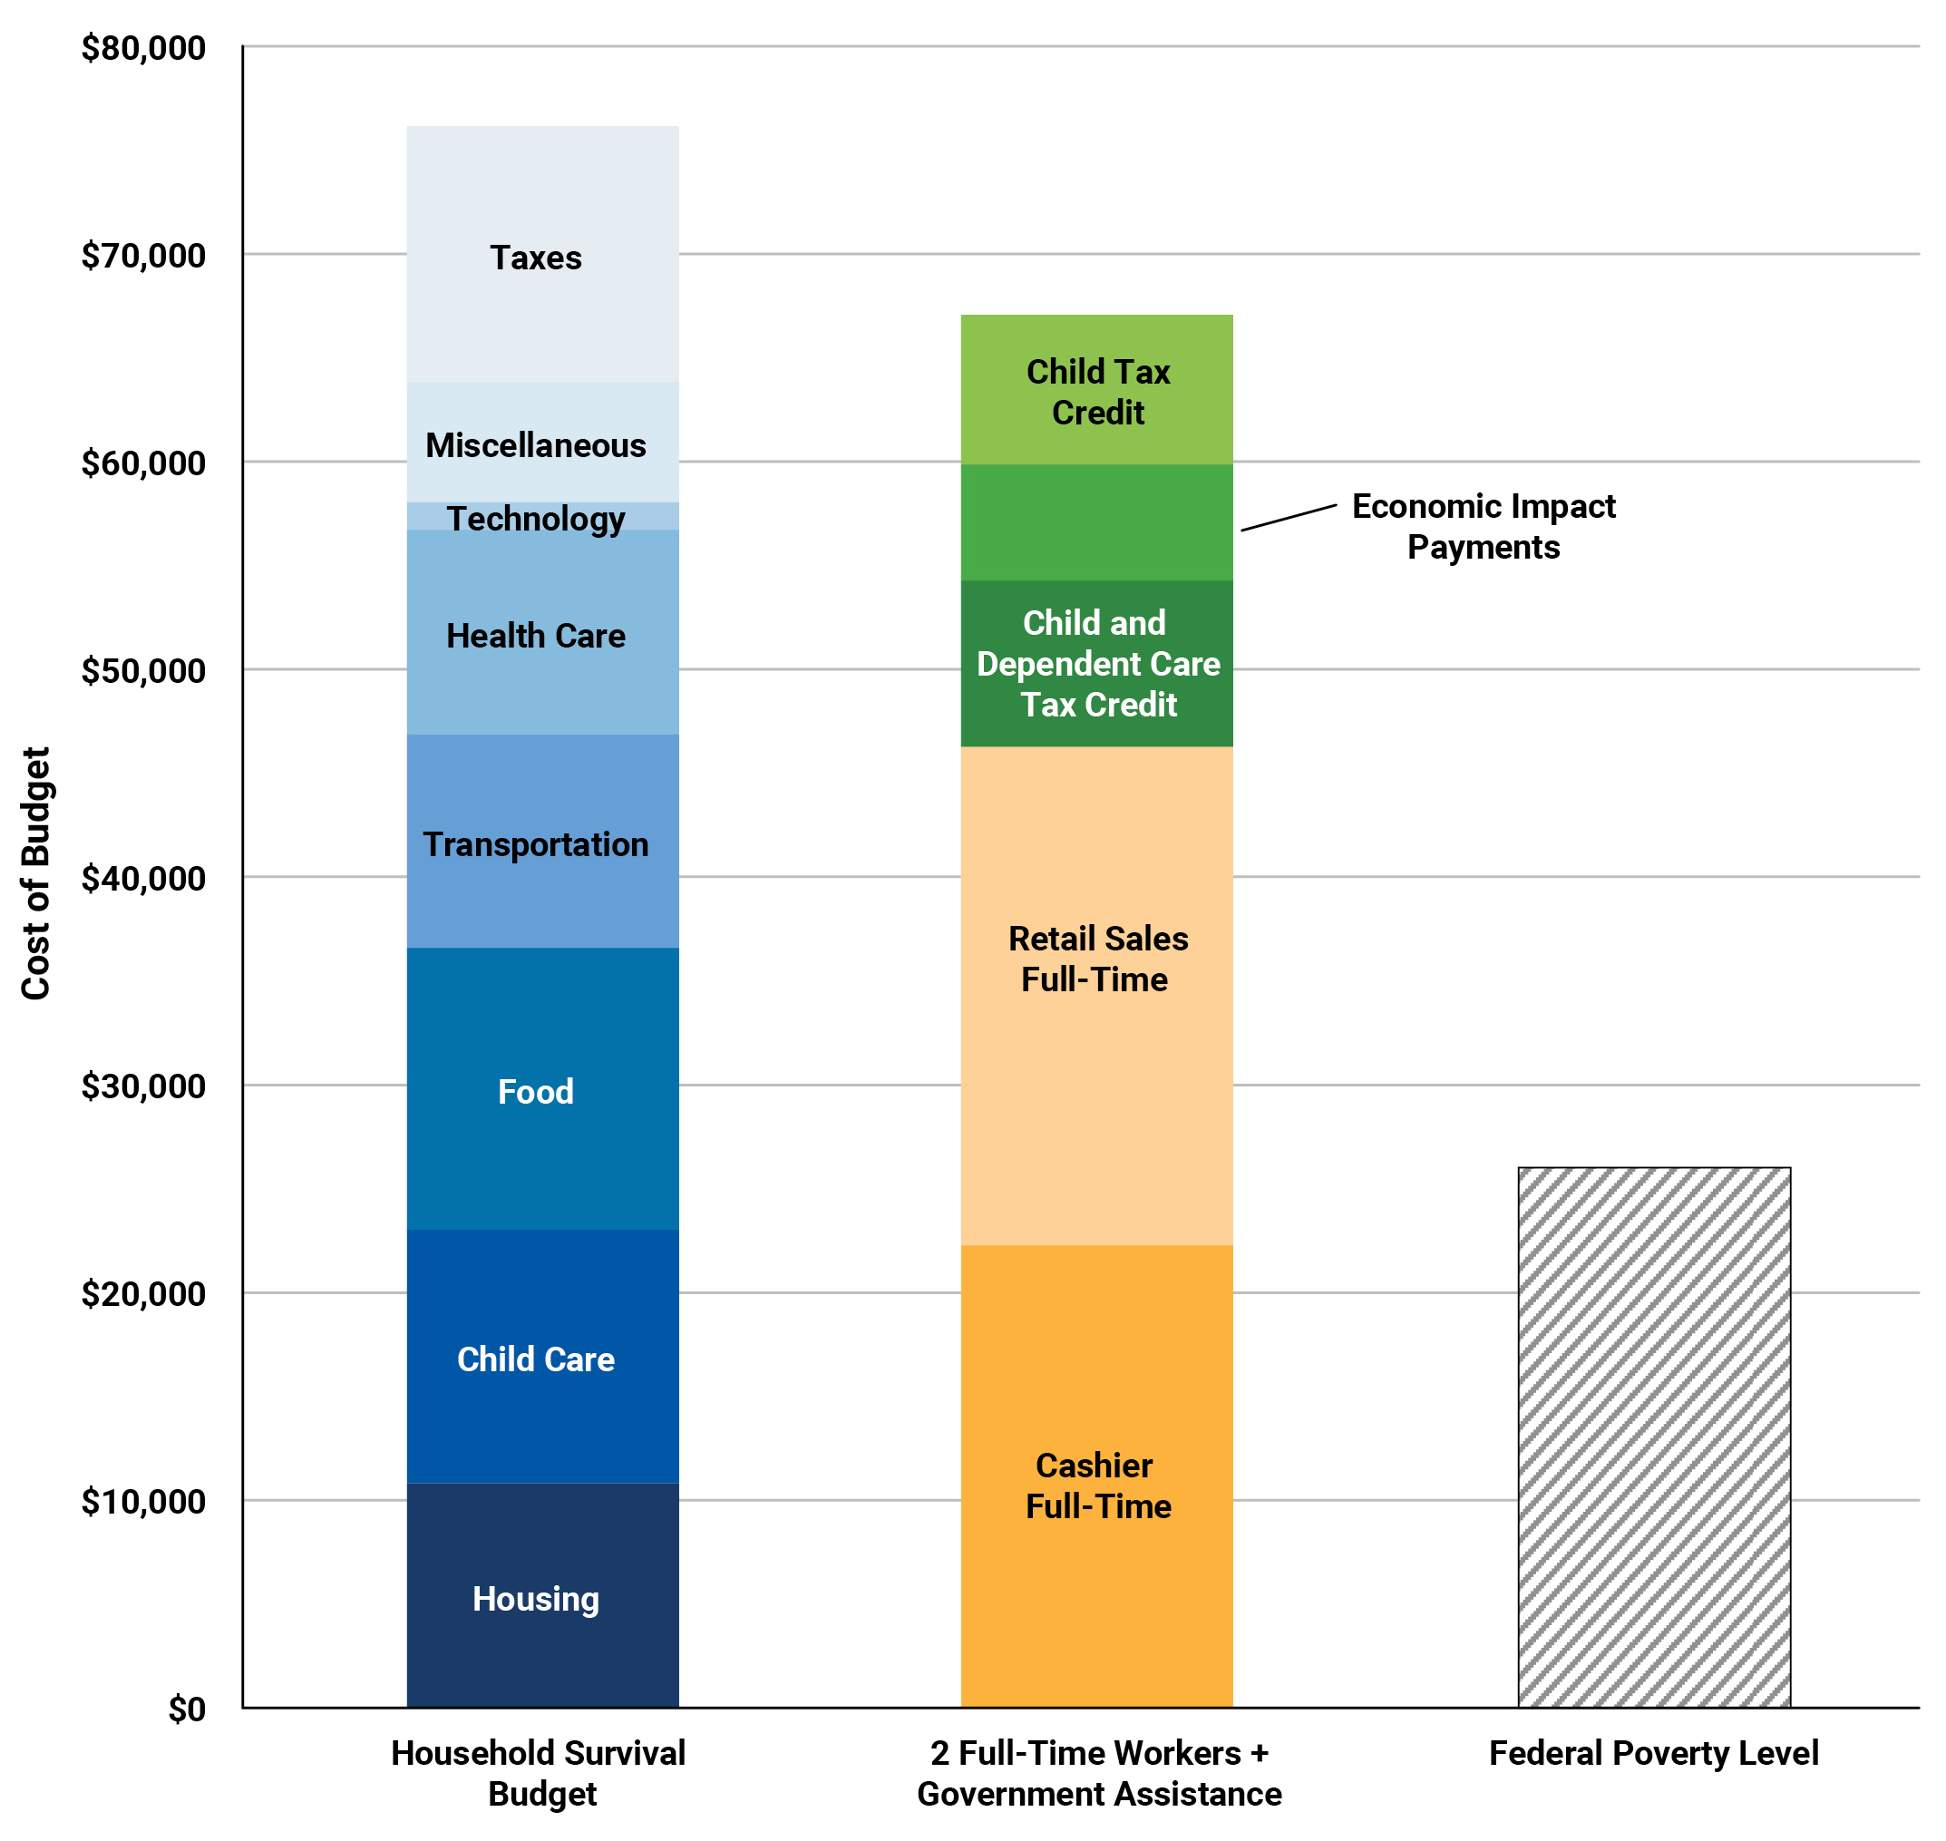
Costs vs. Wages and Assistance
Family of four with two children and two adults working full-time as a cashier and a retail salesperson
Annual income fell short
by $9,060, or 14% of their income, even with the temporarily expanded
credits and payments available to them

Slide 17
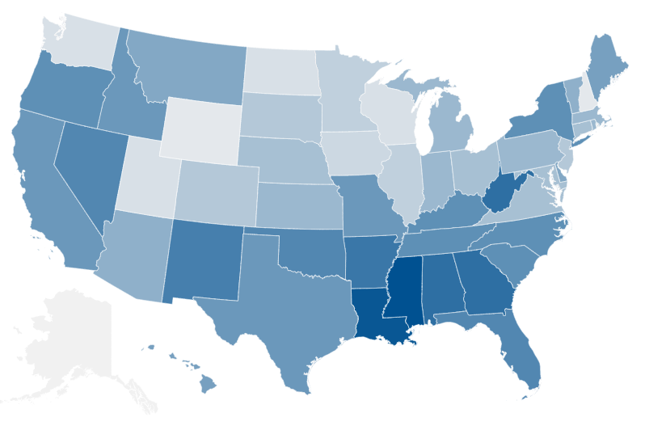

How Does Georgia Compare?
In every state, at least one-third of households could not afford the
basics in 2021
Range from 32% below the ALICE Threshold in AK to 52% in MS
GA ranks #47
Below ALICE Threshold by region:
  Midwest: 37%
  Northeast: 39%
  West: 40%
  South: 45%
Notes:
In every state, at least 32% (nearly one-third) of households could not afford the basics in 2021. The percentage of struggling households ranges from a low of 32% in Alaska to a high of 52% in Mississippi.
There were stark differences by region: The share of households unable to afford basics in 2021 was lowest in the Midwest at 37% and highest in the South at 45%, with rates of 39% in the Northeast and 40% in the West.
Rates of financial hardship varied across the country, less than 35% in Alaska, New Hampshire, North Dakota, Utah, Washington, Wisconsin and Wyoming to more than half in Louisiana and Mississippi.

Slide 18
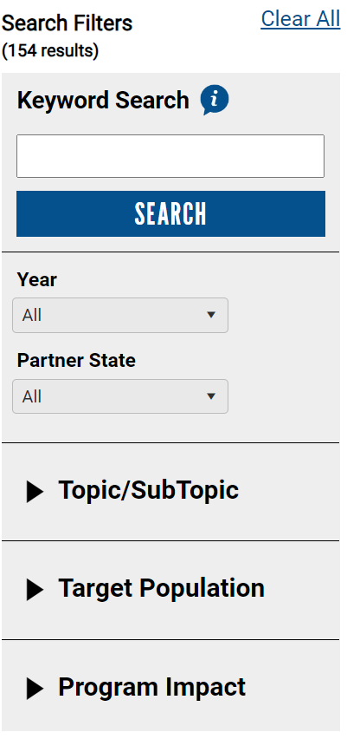
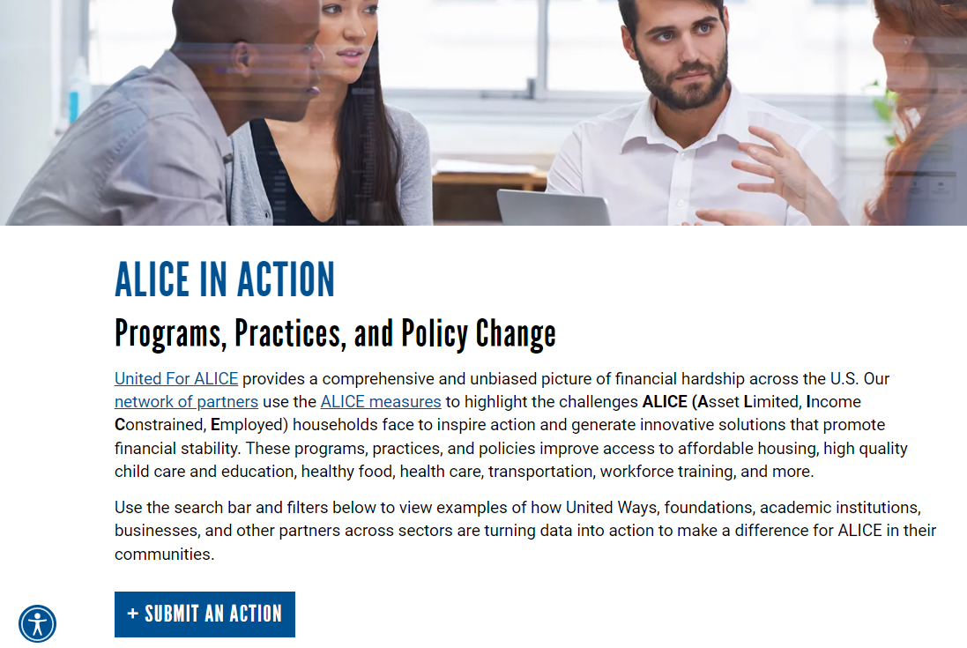
ALICE in Action
UnitedForALICE.org/ALICE-in-Action

Slide 19
Success Stories and ALICE in Action
Medical Debt
Volunteer Income Tax Assistance (VITA)
Technology accessibility
Federal Reserve Bank of Atlanta
Benefits CLIFF Tool (Career Ladder Identifier & Financial Forecaster)
Nurse’s Pantry
ALICE Lives Here/Community Roundtables
Adjusted Funding Priorities
UnitedForALICE.org/ALICE-in-Action

Slide 20
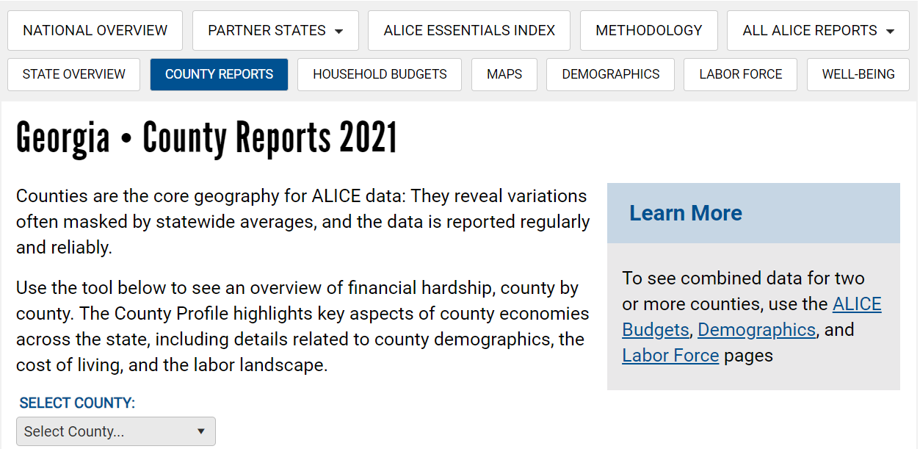
How can YOU use ALICE data?
www.UnitedforALICE.org
    Interactive maps by county, zip code, subdivision, legislative district and more

Slide 21
How can YOU use ALICE data?
This tool is available to you at no cost
Think about ways to collaborate with other non-profits to have a greater impact
Invite us to present to your stakeholders so we can strategize on ways to uplift this hidden pocket of hardworking families
Brainstorm ways YOU can use this ALICE data to impact your community

Slide 22
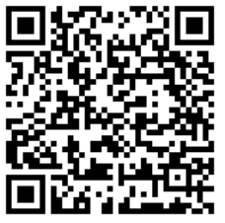



www.UnitedforALICE.org

Slide 23
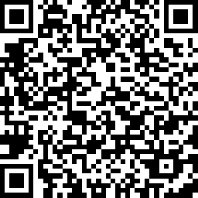
Sponsored by:

