Slide 1
2025 Community Grants Nonprofit Training
Notes:
Matt
Community Leadership of CFCSRA --

Slide 2
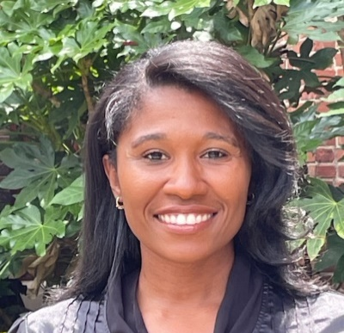
Rebecca Wallace
VP of Programs
rebeccawallace@cfcsra.org
Cell: 706.910.6371
Lasima Turmon
Sr. Program Officer
lasimaturmon@cfcsra.org
Cell: 762.684.6815
Erin Starnes
Program and Scholarship Officer
erinstarnes@cfcsra.org
Cell: 910.638.0826
Office: 706.724.1314 Website: www.cfcsra.org

Slide 3
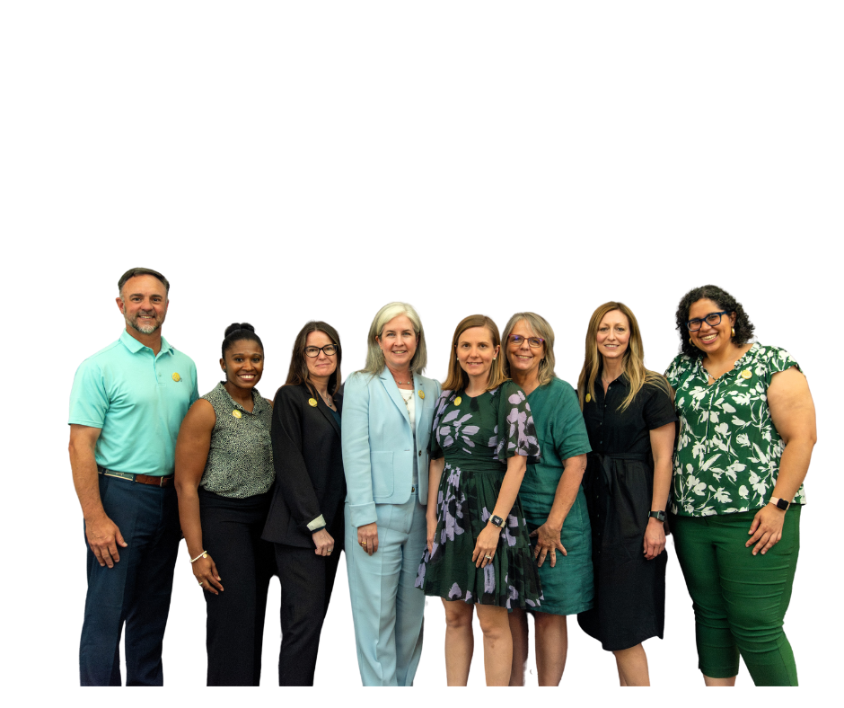
The Community Foundation Team
Notes:
R

Slide 4
Notes:
Matt…
Our mission – engage, inform, and inspire donors to build a stronger & more vibrant community
We exist to impact the community we love
Make August radically better…we do this in three ways…

Slide 5
Notes:
Matt:
Three buckets of work: make our community better!
You as Professional Advisors in trusted spaces with people are partners with us.
Community Endowment / Foundation

Slide 6
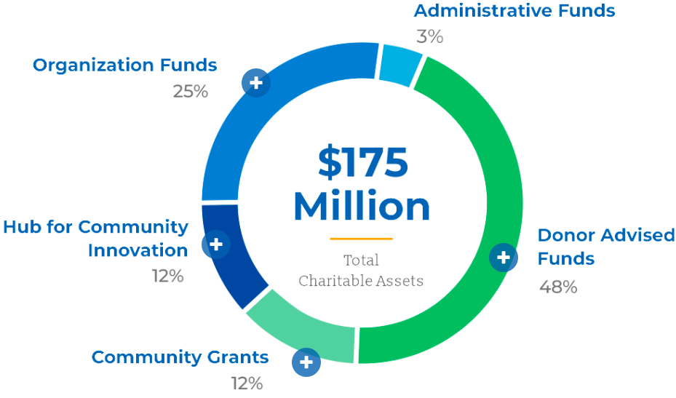
Notes:
R AND M

Slide 7
Program Department of the Community Foundation More Than Just Community Grants
Augusta Bar Foundation Vinea Foundation J.B. White Foundation
St. Joseph Foundation
Women In Philanthropy
Border Bash Mary Warren Sand Hills Garden Club

Slide 8
What is the Community Grants Program?
Annual, competitive process supported by the Community Grants Fund
Consistent funding to address current needs of the community
Evaluation process leads to awards based on identified community needs and relative merit of the proposals received
Historically supported by the Augusta National Golf Club and now also funded through other donor funds.
STOCKS
IRA DISTRIBUTION
REAL ESTATE
CASH
SELLING A BUSINESS
Notes:
Shell

Slide 9
Augusta National Golf Club
Employee Giving Process
The Augusta National Golf Club partners with the Community Foundation to provide its employees with a list of local nonprofit organizations each year.
Organizations that apply for a Community Grant and make it through the initial phases of the application and receive a site visit are the organizations that appear on the Employee Giving list each year.
ANGC shares the list of organizations with their staff who have the opportunity to select which organization(s) they would like to designate funding to.
Since the Community Grants Program is an annual program, the organizations that appear on the Employee Giving List each year will change based on which organizations apply and make it through the initial phases of the application process.

Slide 10
What is the Range of Grant Amounts?
No minimum
Request cannot exceed $15,000
Community panel volunteers review applications, perform site visits, and rank applicants from 5 to 1, with 5 being the highest. Typically, a 5 will get the total amount requested. Based on the amount of funds remaining, the 4th ranked agency will receive a percentage of funds requested.

Slide 11
Who is Eligible to Apply?
501(c)(3)
The Community Foundation for the CSRA only considers applications from organizations providing programs and services directly benefiting individuals living in Aiken and Edgefield counties in South Carolina, and Burke, Columbia, Richmond, and McDuffie counties in Georgia.
One Community Grant Application per year per 501(c)3 organization

Slide 12
May I Apply as a New 501(c)3 Organization
or a Nonprofit that is new to the Community Foundation?
We will consider a start-up (less than 3 years of operations)
We will consider funding Nonprofits that do not already have a relationship with the Foundation
To be considered, a start-up or new nonprofit can’t duplicate services already provided in your service community unless an unmet need can be documented
Reviewed on a case-by-case basis for such things as:
Addresses a significant, measurable need
Organization can effectively address the need
Organization’s likelihood of achieving outcomes
Organization has plans to ensure its long-term viability
Organization has demonstrated they have spoken to and are working with other community partners
NEW 2025: All new nonprofits and those without an existing relationship with the Foundation MUST complete their application by the EARLY DEADLINE of July 15th at 12 PM

Slide 13
In What Areas Do You Fund?
Arts/Culture/History
Recognizing the positive impact art, cultural and historical organizations have on a community, we welcome high-quality applications in this area.
Education/Youth Enrichment
We welcome applications from organizations that provide enrichment and educational opportunities to disadvantaged children, youth and adults. Examples include: job skills training and/or placement, after school or summer programs, leadership mentoring, tutoring, GED and literacy programs.

Slide 14
In What Areas Do You Fund? (cont’d)
Health/Environmental
Some examples of programs in this funding area include: environmental research or management, animal services, programs that support sustainable community and backyard gardens, medical clinics, drug rehabilitation programs and medical programs for persons with disabilities or mental illness.
People in Need
This category is generally, but not exclusively, for human service programs that work with people in need. Examples include: feeding, housing, financial assistance, programs serving the homeless and programs for recently incarcerated individuals.

Slide 15
What Don’t You Fund?
Grants to individuals
Capital Campaigns
Deficit financing and debt retirement
Endowments
Political Organizations or campaigns
Lobbying legislators or influencing elections
Marketing as the entirety of your grant request
Special fundraising events/celebrations
Regranting
Personal research
Programs requiring faith-based participation
Projects that are typically the funding responsibility of the government
Scholarships to schools, colleges or universities outside of our six-county region
Programs that have already taken place or will be completed in the current calendar year

Slide 16
Problem Areas That We’ve Seen
Help Notes throughout the application – pay attention to them
Project Description – this is your gateway to tell why your grant is important
Budget Table – take your time, follow directions, ask questions if needed
Outcomes – Use all three steps
Partnerships – It is never good to put N/A
Organizational Profile – Remember to check your organizational information each time you complete a new grant. Make corrections when needed to contacts, addresses and other permanent information on a regular basis.
Application vetting is more rigorous - threshold review by internal staff will be looking at these items.
Notes:
L

Slide 17
What Should I Emphasize?
Strong applications will need to tell the story of your organization and the importance of your mission to the community to include:
Impact on persons/the community
Develop competencies and skills in an individual
Address a demonstratable, significant need
Leverage other funding
How you partner with other agencies
Demonstrate capacity to provide services
Demonstrate support from volunteers and in-kind resources
Promote systems or approaches that have the ability to prevent or solve problems
Be sure that your response to the questions above reflect the six-county service area

Slide 18
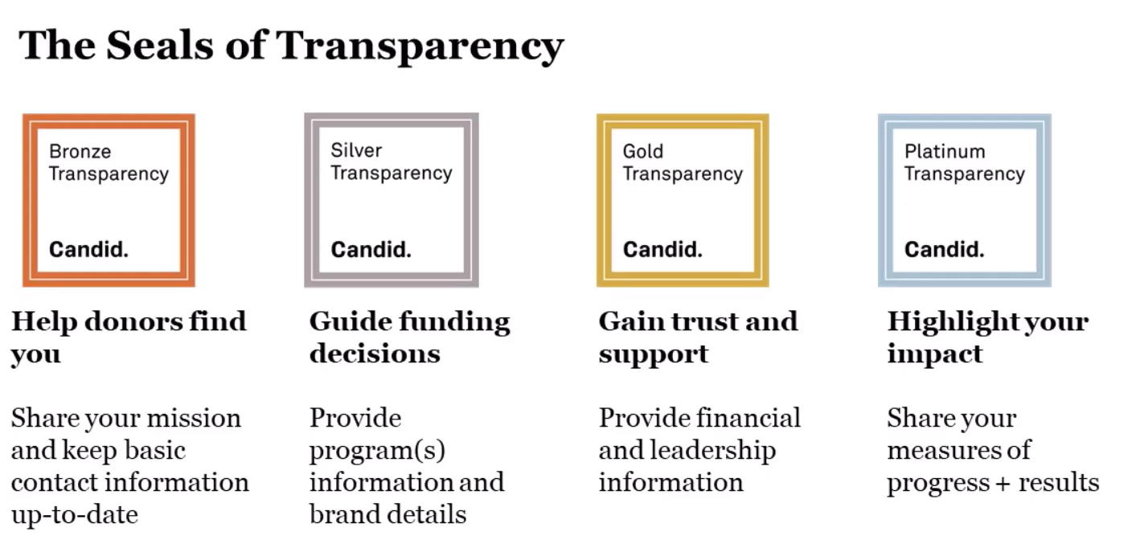
GuideStar
Why it Matters
You already have one
Data from IRS or nonprofits directly
Charitable partner use
Seals demonstrate commitment to transparency & build confidence in your organization
Seals can expire – update your information minimally every 2 years

Slide 19
Questions?

Slide 20
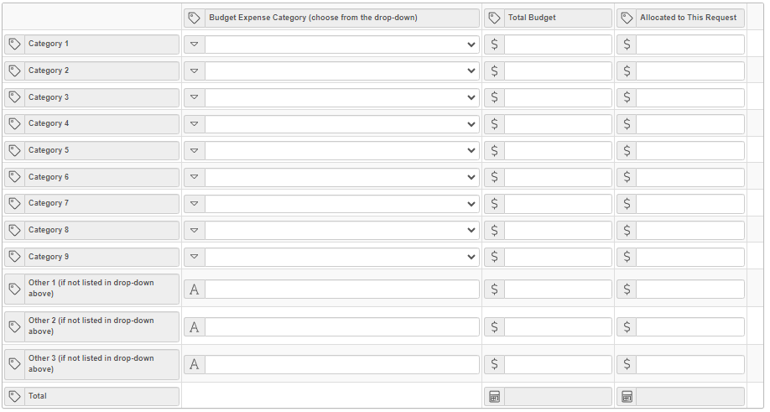
Budget Table
The drop-down menu lets you select your budget categories.
Employees
Employee Benefits
Professional Development Contract Services
Overhead Costs
Direct Services
Scholarships
Equipment
Supplies
Marketing
In-Kind
BEST PRACTICE: You are no longer required to show income sources on your program budget, but your panel will probably ask you about income, so be prepared to speak to them at your site visit.

Slide 21
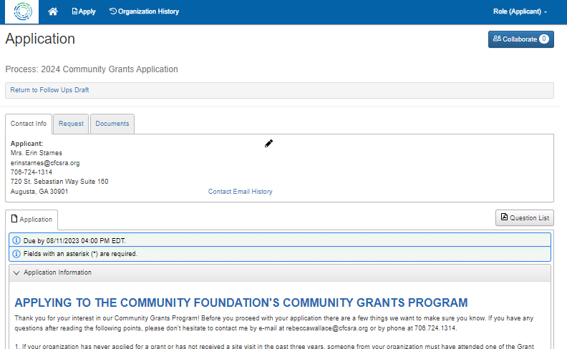
Need to Collaborate?
The Collaborate feature allows you to invite others to work with you on your application.
Notes:
ERIN

Slide 22
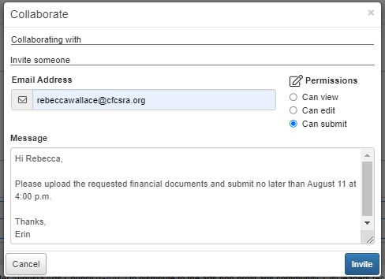
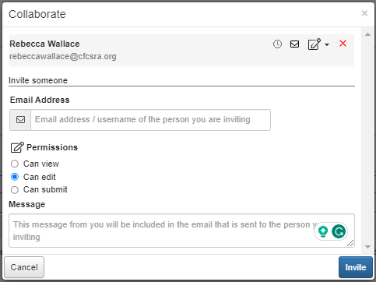
Need to Collaborate?
Enter the email address of the person you’d like to collaborate with on your request.
Type a message to that person, including any specific instructions about questions you'd like them to complete or review.
Select the permission level for this collaborator (view, edit, or submit).
These collaborator permissions apply to all forms within your request (e.g. the application and any follow-ups assigned to you). If you select edit, for example, the collaborator can edit any forms within your request.
Need to edit your invitation? Click the Collaborate button again to do any of the following:
Resend the invitation
Edit user permission
Remove or add a collaborator
Collaborator Tutorial
Notes:
ERIN

Slide 23
Early Review Option
CFCSRA staff will review your application and provide feedback.
DO NOT SUBMIT AN INCOMPLETE APPLICATION!
Submit the application as if you were submitting it for the final deadline.
Ensure you upload correct attachments in the appropriate fields
NEW 2025: When you receive staff feedback, please make suggested changes to your application. Not doing so may keep your application from moving through to a panel sight visit
NOTE: Your application will only be returned to you if changes are needed. Do not submit an early application assuming you can make changes later. If staff deems that no changes are needed, you will be notified that your application will move on to the next phase.
NOTE: If the application is released back to you for corrections it will appear in your organizational profile in a “draft” state. Once you’ve made changes you will need to resubmit the application before the final deadline.

Slide 24
Finalizing Your Application
You may save and return to your application at any time
The person who can answer questions about your application and will organize your site visit should be the contact person for your application.
Ensure you upload correct attachments in the appropriate fields
PUSH SUBMIT! If you submit for the early deadline, make sure you re-submit before the final deadline
BEST PRACTICE: Have another person proof your application before pressing submit
On our website, you will also find:
Grant Seeker Guidelines
Help on how to create budgets and write outcomes
How to prepare for a site visit

Slide 25
Is a Site Visit Really Important?
A compelling grant is not enough to secure funding. Most, if not all, of the grants we receive, deserve consideration for funding.
Not all applicants receive a site visit. To receive a site visit, an applicant must submit a complete application with correct financials, budgets, and other supporting documents as requested in the application by the deadline. The request must meet standards as outlined in the granting guidelines.
The site visit is an opportunity to secure your organization's chance to receive funding. Prepare for this visit with that thought in mind, and “sell” your grant proposal and organization to your panel!
NEW 2025: Staff may not recommend your grant for a site visit, even if this basic criteria was met, if staff feels you did not adequately make your case for funding consideration.
BEST PRACTICE: Make sure the person who wrote the grant preps those who will be present at the site visit. A best practice would be for that person to also attend.
Notes:
REBECCA

Slide 26
Why Are You Doing Youth Panels?
Why we feel it’s important
We are growing future volunteers, philanthropists, fellow citizens who know and care about our community.
Accountability
The adult chair walks with the youth throughout the entire process and makes sure they understand the importance of their role.
Knowledge
The youth volunteers go through a specialized training with their Panel Chair. They, like adult panels, read your applications, attend site visits and take part in a group discussion on why they recommend specific organizations for funding.
BEST PRACTICE: Treat your youth panel with the same respect you would show to any other panel.

Slide 27
If Funded, are there Reporting Requirements?
If your grant application is for a summer-only program that is completed by the time the new school year begins, or is for a single item purchase, AND you have met all your outcomes, you will not be required to complete a mid-year report, you will only do a final report
Stories Matter – when doing your reports we want to know lives were impacted. Tell us your stories and share quality photos
All agreements and reports will be done through the Grants Portal. Please observe posted deadlines. You will receive a reminder 14 days before any follow-up report is due
Submit a mid-year report by July 15, 2025
Submit a final year-end report by January 9, 2026

Slide 28
CFCSRA Grants Portal What you need to know
All communications about your application will be done through the Grants Portal and will come to the staff person and email address that you entered as the contact for that grant.
Add administrator@grantinterface.com to your allowed emails. System-generated notifications, report reminders and other grant-related communications will come from this email address.
You will be able to complete and upload all needed information directly through your organizational account. Please don’t mail or email these documents directly to us.
Your organizational grant history will remain on your page in the Grants Portal. You will be able to see all applications, your funding history, submitted reports, and agreements.
Applications for Augusta Bar Foundation, Greater Augusta Arts Council, JB White Fund, Mary Warren Fund, Sand Hills Garden Club, St. Joseph Foundation, and Women in Philanthropy are all hosted on the Community Foundation’s Grants Portal.

Slide 29
What is the Award Process?
Applications are reviewed and released for changes if in by the early deadline of July 15 at 12:00 p.m.
Applications submitted after the early deadline but prior to the deadline on August 9 at 4:00 p.m., are reviewed and either declined or sent to Grants Committee
Full Board of Directors affirm vote by Grants Committee
The annual press conference will be held Friday, December 6
Applicants receive notice of funding prior to Thanksgiving weekend
Panel recommendations given to Grants Committee for approval in November
Panel site visits will be conducted starting October 1 but no later than October 31.
Grants Committee reviews the work of the staff and approves their recommendations for site visits
Funds are distributed no later than the end of January 2025

Slide 30
What are the Deadlines?
Application opens on July 1, 2024, and will be accepted through August 9, 2024
BEST PRACTICE: The Early Deadline for review with feedback is July 15 at 12:00 pm
NEW 2025: Final Deadline for new nonprofits or those who have no relationship with the Foundation is July 15 at 12:00 pm
The Final Deadline is August 9 at 4:00 pm. No exceptions.

Slide 31
Questions?

Slide 32
Using the Grants Portal
Notes:
ERIN

Slide 33
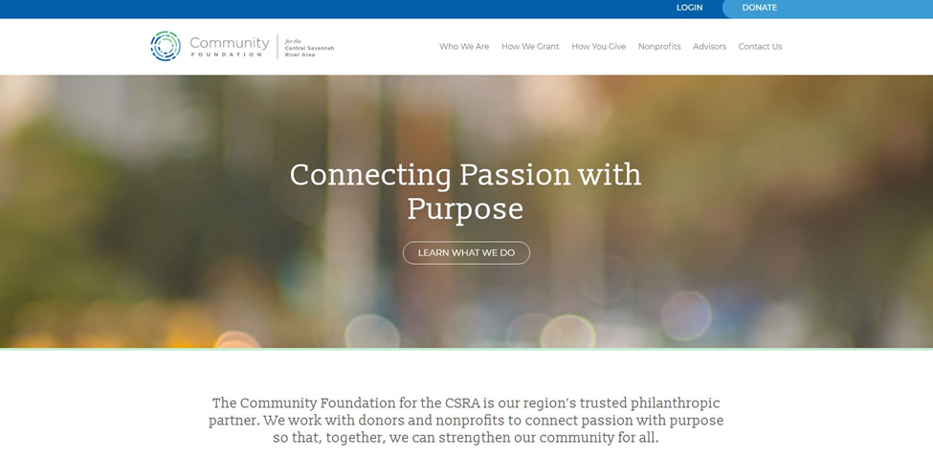
How Do I Get Started?

Slide 34
New Organization?
You will need to create a new organizational profile to include contacts before starting your application.
All future applications that are completed in our Grants Portal will be linked to the organization.
New Employee, Existing Organization Profile?
Contact Erin to be added to your organizational profile.

Slide 35
Already Have a Profile?
If you have already applied for another grant through our Grants Portal (launched in March 2020)
BEST PRACTICE: Review your organizational profile, contacts, and your EFT information before starting your Community Grant Application. Update as needed prior to starting this or any other application.

Slide 36
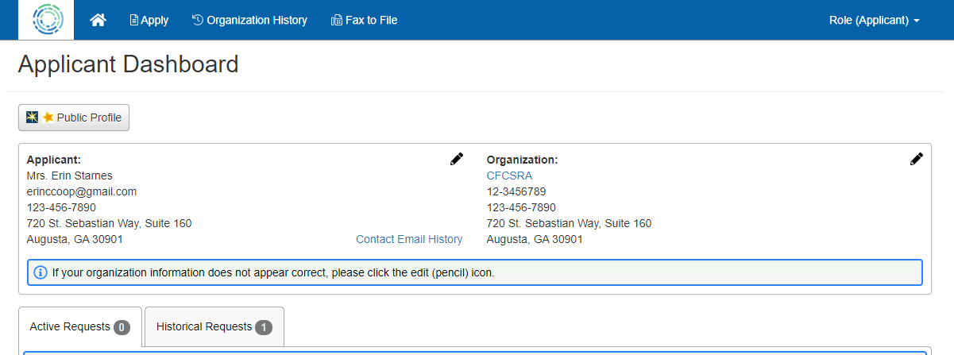
Once you are logged in, you will land on your Applicant Dashboard. Click the “Apply” icon to see the list of open grant opportunities

Slide 37
Click the “Apply” button that corresponds with the grant name
and description for the 2025 Community Grants Program

Slide 38
CFCSRA Grants Portal What you need to know
All grant agreements, reports and other communications about your application will be done through the Grants Portal. Please observe posted deadlines. You will receive a reminder 14 days before any follow-up report is due.
Add administrator@grantinterface.com to your allowed emails. System-generated notifications, report reminders and other grant-related communications will come from this email address.
You will be able to complete and upload all needed information directly through your organizational account. Please don’t mail or email these documents directly to us.
Your organizational grant history will remain on your page in the Grants Portal. You will be able to see all applications, your funding history, submitted reports, and agreements.
Applications for Augusta Bar Foundation, Greater Augusta Arts Council, JB White Fund, Mary Warren Fund, Sand Hills Garden Club, St. Joseph Foundation, and Women in Philanthropy are all hosted on the Community Foundation’s Grants Portal.

Slide 39
Questions?

